Slide 1
Introduction & ChatGPT (LLM)
ICS625 – Artificial Intelligence
and Machine Learning
Summer 2023

Slide 2

Truth – The one thing AI does not do
If I could only give three words of advice, they would be,
'Tell the truth.'
If I got three more words, I'd add,
'All the time.'
Never trust AI. It will lie to you without reservation. It does not even know when it is lying.
AI is like an obsequious servant that tells you what you want to hear.
Randy Pausch – 1960-2008

Slide 3

Ethical Artificial Intelligence – is an OxyMoron
To date, every attempt at ethical AI has been the regurgitated politics of the developer. The idea that you can code “ethics” is absurd.
You might just as well try to create an ethical chainsaw.
If AI doesn’t disturb you, you’re not paying attention.

Slide 4
What about Artificial Intelligence?
Where’s the Data?
Computers are still subject to GIGO
Garbage IN, Garbage OUT.
How much Data is there?
Who owns the Data?
How clean is the Data?
Can the Data be converted to numbers?
What are the 3 most important parts of AI?
The Data, The Data, The Data

Slide 5
ICS625 - The Objective
Create a Framework that will allow us to:
Evaluate
Recommend
Troubleshoot
An existing or potential AI implementation

Slide 6
Sources
Open file: “ICS625 Summer 2023 sources.docx”
“Working with AI” by Davenport and Miller
GITHUB Repository - Data science & Machine Learning in Production
https://github.com/eugeneyan/applied-ml
Review document: github_applied_ML.docx
“Artificial Intelligence – A Modern Approach” by Stuart J. Russell and Peter Norvig – 3rd Edition
Supplemental videos from Professor Groom
File: “MLOps-A Holistic Approach White Paper WANDB.pdf”

Slide 7
Assigments
No Tests
Weekly writing assignment
1-2 page paper created using ChatGPT
Basic Process – (More specific detail on the Canvas Assignment pages)
With ChatGPT (or other LLM) create a paper on the subject
Research the subject, error check the created paper
Rewrite the paper, improve logical flow, correct any errors, improve content and make the paper readable.
Submit both papers for grading and peer review
## Note a change from video -
Weekly Peer review – CHANGE to Weekly Discussion
Each week every student will be assigned 3 papers to peer review
Each week there will be a Discussion board where everyone will post their writing assignment for open discussion
Professor Groom Class videos
Each week watch a video from Professor Groom’s original ICS625 course

Slide 8
ChatGPT – the good, the bad & the ugly
As of early 2023 , GPT-3 was largest LLM created
Cost $12 million for one training run
Surprised early users and developers
Generated coherent & fluent txt on a wide range of topics
Had a Mary Shelly moment – “It’s Alive!”
Trained on 570 Gigabytes of data
Can’t tell you what it was trained on
Can’t site or credit the source of facts or opinions
References will be fabricated
Modified to exhibit “ethical behavior”
The regurgitated politics of the developers
Does not have access to the Internet
Cutoff Date 2021 – not searching or evaluating current information

Slide 9
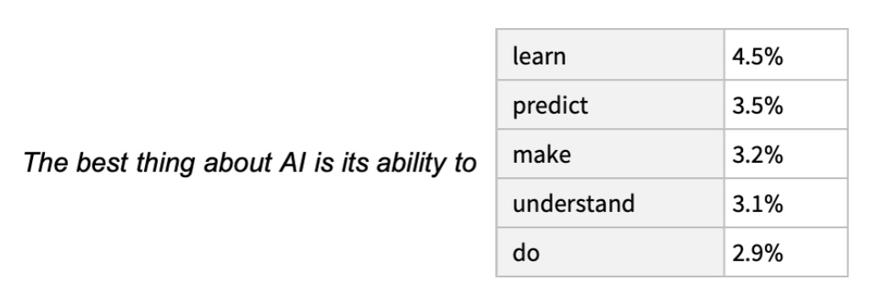
ChatGPT – Large Language Model (LLM)
What is ChatGPT doing…and Why does it work?
Read Stephen Wolfram’s article:
https://writings.stephenwolfram.com/2023/02/what-is-chatgpt-doing-and-why-does-it-work/
“The first thing to explain is that what ChatGPT is always fundamentally trying to do is to produce a “reasonable continuation” of whatever text it’s got so far, where by “reasonable” we mean “what one might expect someone to write after seeing what people have written on billions of webpages, etc.” Stephen Wolfram’
ChatGPT was trained on 570 Gigabytes of data. The program knows the statistical occurrence of words.

Slide 10
ChatGPT – A Tool
This is a powerful, dangerous tool – it is like a chainsaw – if you are careless it will cut off your legs
GRAPHIC IMAGE REMOVED

Slide 11
ChatGPT - Very Useful Tool
Stimulate Creativity
Dissolve Writer’s Block
Make plans
List alternatives
Gather Information
Act as a personal tutor

Slide 12
Harry Potter Wand – v.1
Note the Cite detail
Author
LLM Name
LLM version
Date Created
LLM Prompt as submitted
Note – LLM generated material cannot be cited with a URL link. If you submit the same prompt a second time, the results will not be identical
LLM Prompt: Write a one page paper on the wands that Harry Potter used.
Potential Validation Source

Slide 13
Harry Potter Wand – v.2
LLM Prompt:
Write a one page paper on the wands that Harry Potter used. Provide 3 cites that confirm the accuracy of the information.
Information content appears to be improved.
Sources are referenced and they exist, Pottermore, Harry Potter Wiki, and The Guardian. But would it be possible to find confirmation for the LLM material?
It is typical for ChatGPT to cite believable sources.

Slide 14
Harry Potter Wand – v.3
LLM Prompt:
Write a one page paper on the wands that Harry Potter used. Cite 3 academic papers that confirm the facts in the paper.
Books are referenced:
"The Wand Chooses the Wizard: Magic, Materiality, and the Harry Potter Universe," author Benjamin A. Brabon
"Harry Potter and the Art of Memory: The Power of Storytelling and the Remembrance of Trauma," written by Lana A. Whited and M. Katherine Grimes
"The Magic of Harry Potter: Symbols and Heroes of Fantasy," by Daniel T. Kline and Charles W. Mueller
The authors exist, but not the books. And there are no academic papers cited.

Slide 15
Harry Potter Wand – validation site
The Story of Harry Potter’s wands is more complicated that our LLM can relate
https://harrypotter.fandom.com/wiki/Harry_Potter%27s_wand
That site has a long article about them if you are interested

Slide 16
Week 1 – May 15 – Introduction and ChatGPT
Housekeeping
Course Rationale
ChatGPT requirement
Writing assignment

Slide 17
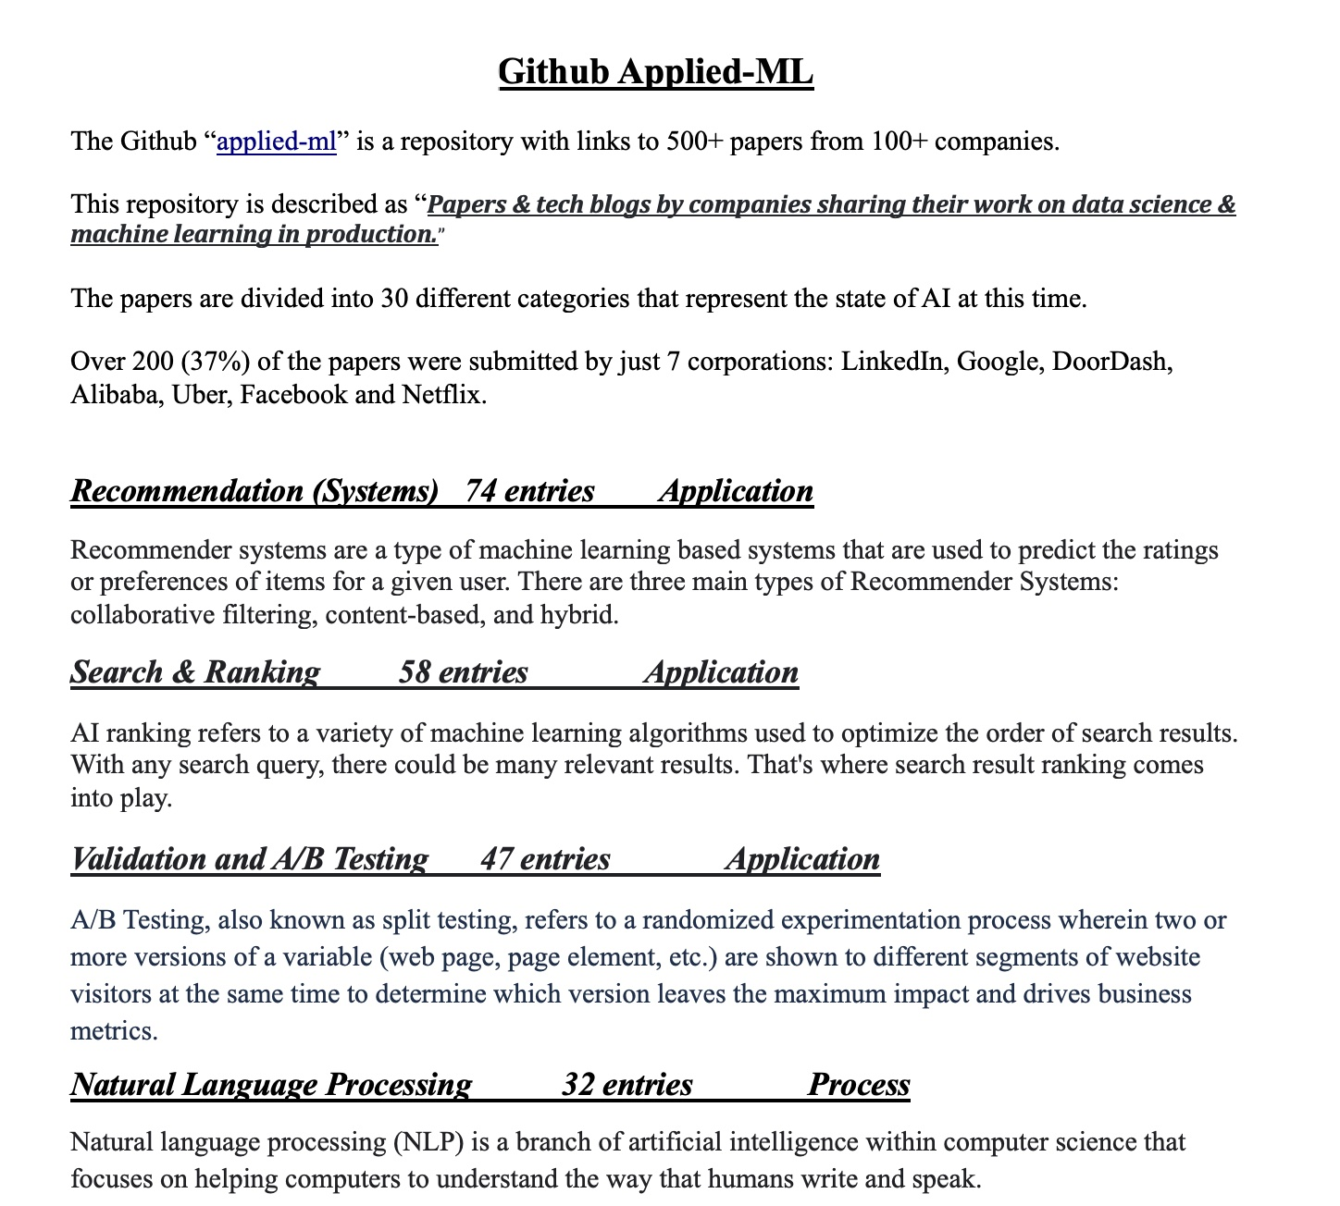
GITHUB Applied ML – docx
Categories:
Categories are ranked by the number of papers they refer to. Of the 30 categories, Recommendation (Systems) are the most popular.

Slide 18
Accessing ChatGPT or Large Language Models
Get access to a Large Language Model. ChatGPT is recommended, but the choice is up to the student. There is a file “alternative_LLMs.pdf” with other LLMs listed – it may be dated, things move fast in this industry.
Go to openai.com, look for “Try ChatGPT”. It will ask you to create an account or login with Google

Slide 19
Week 2 - Ai Agents and AI Demonstration
AI Agents and their Environments
Useful for organizing and thinking about AI implementations
Demo of AI on Google Colab
How it works and importance of Data
Writing assignment
AI Transfer Learning
Required Reading
https://applyingml.com/resources/first-rule-of-ml/
https://applyingml.com/resources/ml-design-docs/

Slide 20
Week 3 - Working with AI and GITHUB repository
Review of several WWAI cases
Discuss how to evaluate them
Explore the GITHUB repository
Connect cases discussed above
Writing Assignement
First “Framework” paper
Select a WWAI case and connect it to GITHUB categories

Slide 21
Week 4 - Working with AI and GITHUB Analysis
Review instructors Framework paper
And some early papers from last week’s assignment
Writing assignment – repeat of last week
Student may select a new case or improve last week’s submission

Slide 22
Week 5 - Working with AI Insight
Review the completed Framework papers that stand out
Discuss the WWAI Insights section
Critical to final Framework
The players may change but the relationships don’t

Slide 23
Week 6 - AI Practices and MLOps (Machine Learning OPS)
Student should have read “MLOps-A Holistic Approach White Paper WANDB.pdf “
MLOps – Machine Learning Operations
AI Practices
Relates to practical implementation issues and ongoing AI management
Writing assignment: Summarize the seven main sources of bias in AI implementions

Slide 24
Week 7 - Framework Design
Review of possible designs for the Framework
Media choice – What works best?
Written
PowerPoint
Video
Main elements
Outline
Writing assignment: Each student to outline their version
ChatGPT may be used, LLM rules apply

Slide 25
Week 8 - Rough Framework
Being Collaborative effort to select an media and outline.
Fill in the outline
Work in progress

Slide 26
Week 9 - Finished Framework
TBD

Slide 27
Week 10 - ICS625 Class Critique
Did this course come up to your expectations?
Will you be able to use what you learned?

